Slide 1
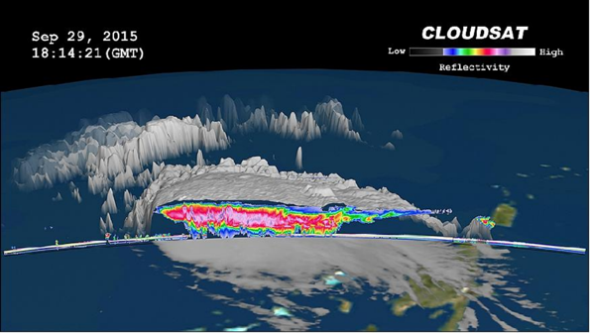
A transfer learning approach to reconstruct ground-cluttered near-surface snowfall profiles from spaceborne radar
Ding Li,
Dr. Chris Fletcher
Dr. Marek Stastna MMATH in CM

Slide 2
What will be covered?
Spaceborne hydrometeor remote sensing background
Ground clutter issue
Impacts: what’s the motivation?
Existing methods: poor in generalizability
Key: domain adaptation
Transfer learning paradigm
Model development
Model results: a milestone victory!
Conclusions and discussions

Slide 3
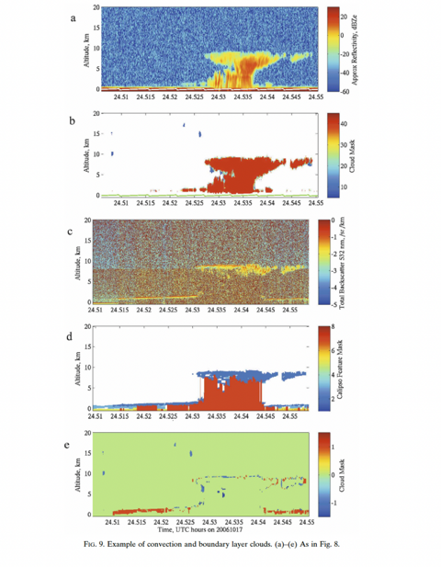
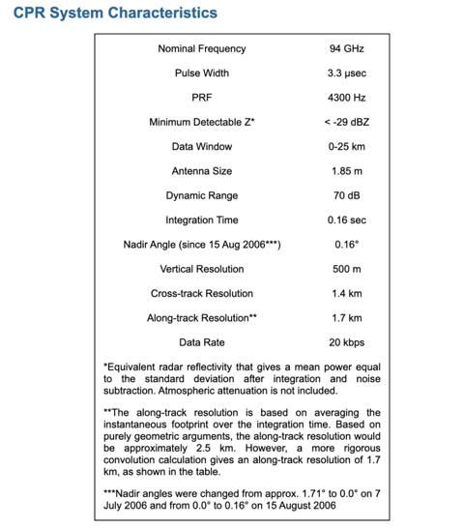
Spaceborne radar
Image credit: Marchand et al., https://doi.org/10.1175/2007JTECHA1006.1

Slide 4
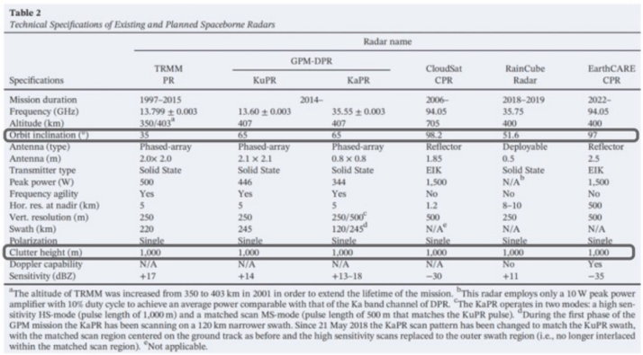
Ground clutter in spaceborne radar
W-band is sensitive to hydrometeors
Good for weak backscatters
But surface reflectivity is much stronger
Oversampling: lowest 1km not available
Table credit: Battaglia et al., https://doi.org/10.1029/2019RG000686

Slide 5
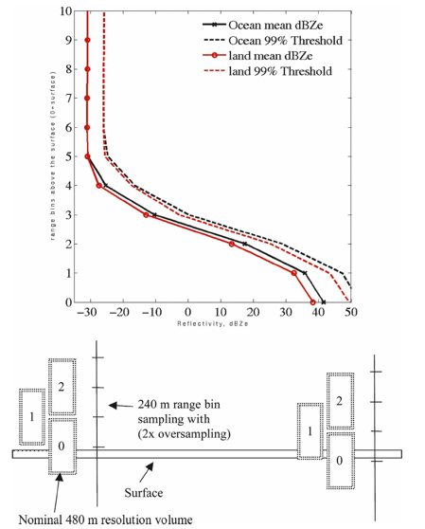
Ground clutter in spaceborne radar
W-band is sensitive to hydrometeors
Good for weak backscatters
But surface reflectivity is much stronger
Oversampling: lowest 1km not available
Image credit: Marchand et al., 2008, https://doi.org/10.1175/2007JTECHA1006.1

Slide 6
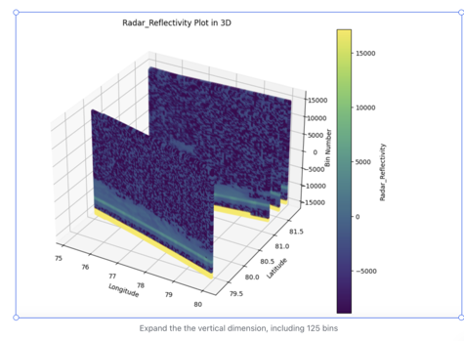
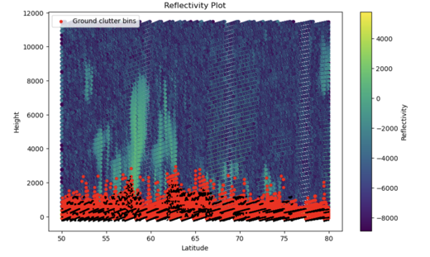
Ground clutter in spaceborne radar
W-band is sensitive to hydrometeors
Good for weak backscatters
But surface reflectivity is much stronger
Oversampling: lowest 1km not available

Slide 7
Impact assessment
Propagates error to downstream research
E.g., model parameterization, projection, validation
Need to estimate its potential error and uncertainty first:
Use ground-based looking-up radars as the ground-truth reference:
Ground-clutter-free
High-quality
But sparse
Only available overland
Can use ARM KaZR

Slide 8
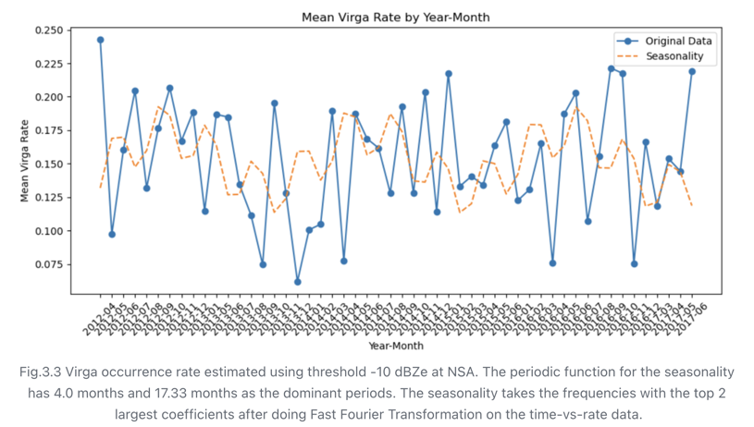
Impact assessment
Overestimation: snowfall occurs but sublimates near the surface

Slide 9
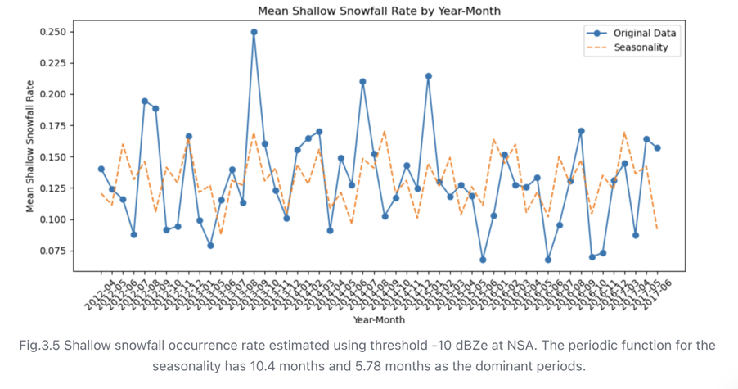
Impact assessment
Underestimation: snowfall occurs undetectable near the surface

Slide 10
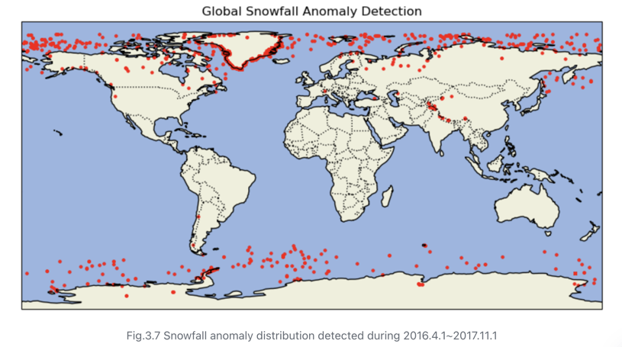
Impact assessment
Snowfall anomaly: Overflowed surface signal

Slide 11
Impact assessment
See more in my other research…
But we are certain that this has to be nailed! For:
Current research using past mission data
Future mission adaptation

Slide 12
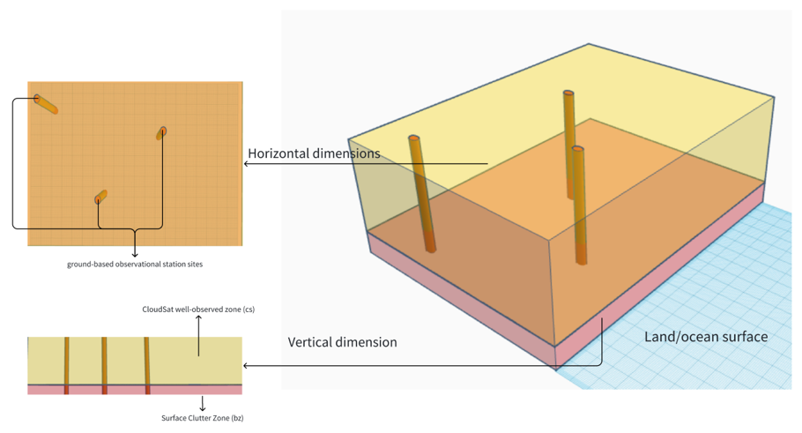
Domain Shift

Slide 13
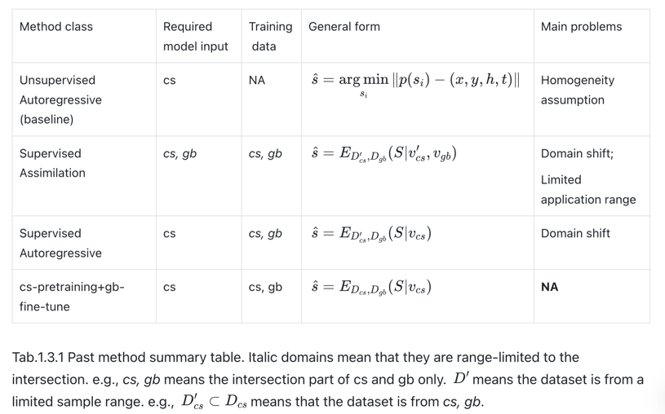
Past adaptation in CloudSat’s snowfall community
Regression/inpainting

Slide 14
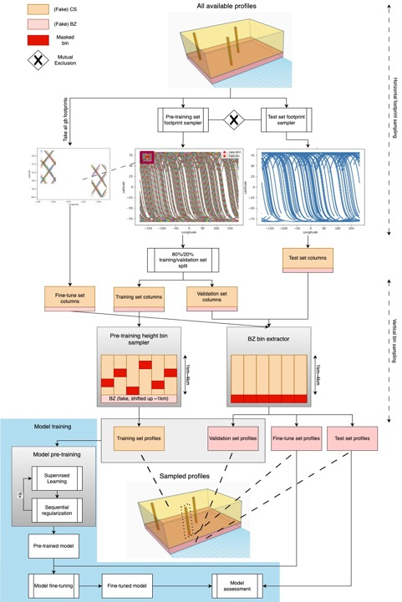
Model training and
benchmarking
Pre-train on cheap cs
Global cs mask-recovery
Sequential regularizations
Fine-tune on expensive gb
Insufficient validation?
Fake it!
Differentiated 2d-sampling
Learn the population in few-shot
Avoid catastrophic forgetting

Slide 15
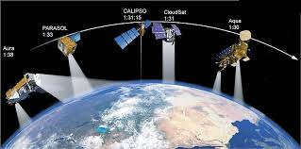
Model conceptual design
Need a model suitable for Transfer Learning:
Domain adaptation
Task transfer: One model trained, many tasks done
Should handle multimodal data flexibly:
Multi-source satellite data
Different sensor/imaging principles
Different spatio-temporal resolutions
Mixture of 2d and 3d
Image credit: NASA photojournal

Slide 16
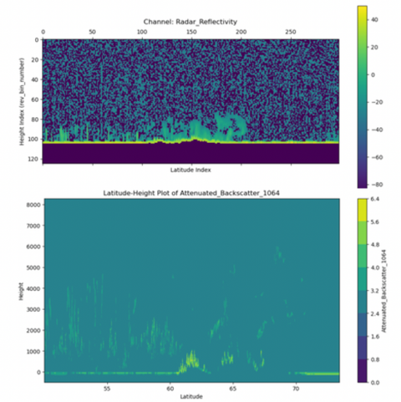
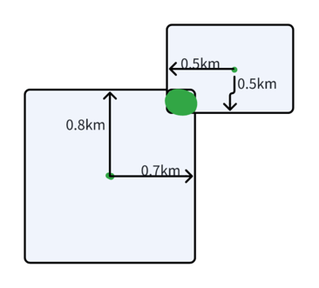
Model conceptual design
Multisource data collocation for complementary information:

Slide 17
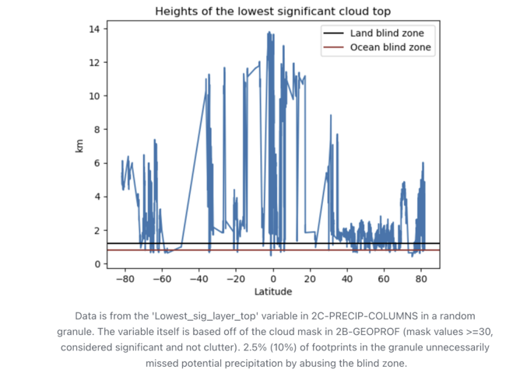
Model conceptual design
Multisource data collocation for complementary information:

Slide 18
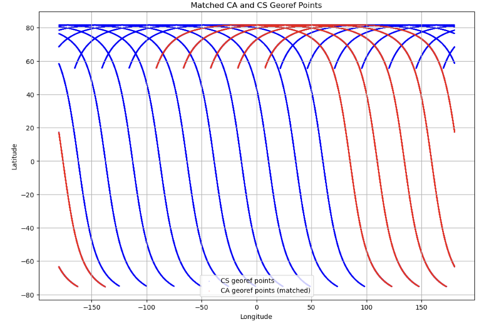
Model conceptual design
Multisource data collocation for complementary information:

Slide 19
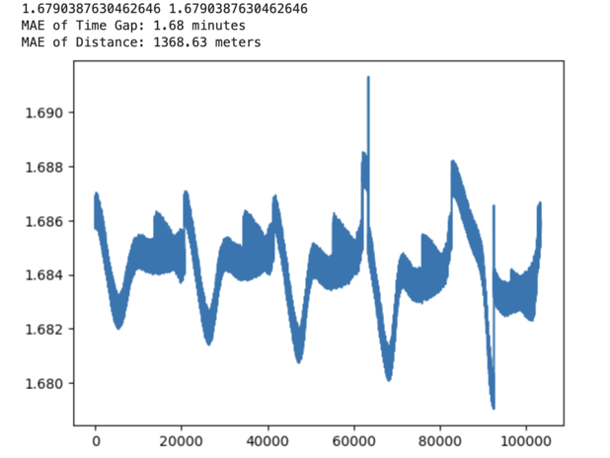
Model conceptual design
Multisource data collocation for complementary information:

Slide 20
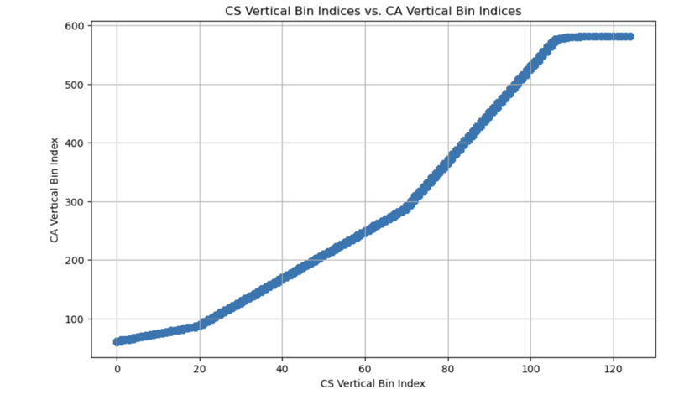
Model conceptual design
Multisource data collocation for complementary information:

Slide 21
Model conceptual design
Multisource data collocation for complementary information:
Device band mismatch: What is the data?
Spatio-temporal mismatch: Resolution and coverage?
Even dimensional mismatch: What are your x and y axes? Is there a z?
Data assimilation and collocation: Reduced available data, only overlapped
Algorithms add errors, and information compression: e.g., k-nearest neighbor
How about you let the model learn to decide itself!

Slide 22

Model conceptual design
(Image credit: Intermediate School 162 The Willoughby School)

Slide 23
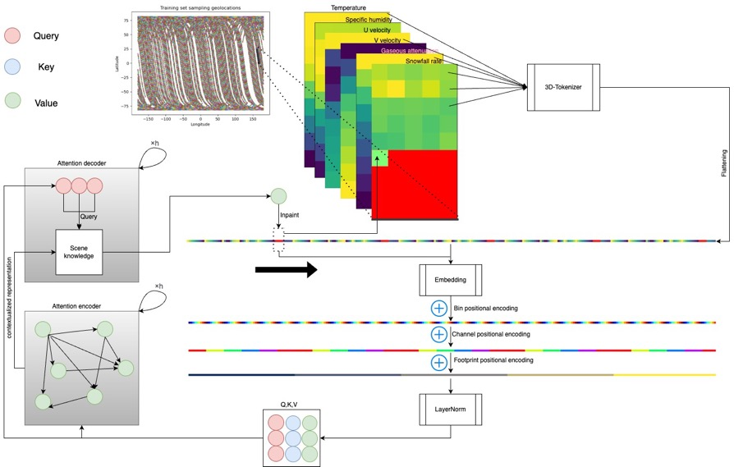
Model architecture

Slide 24
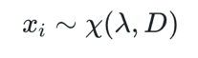
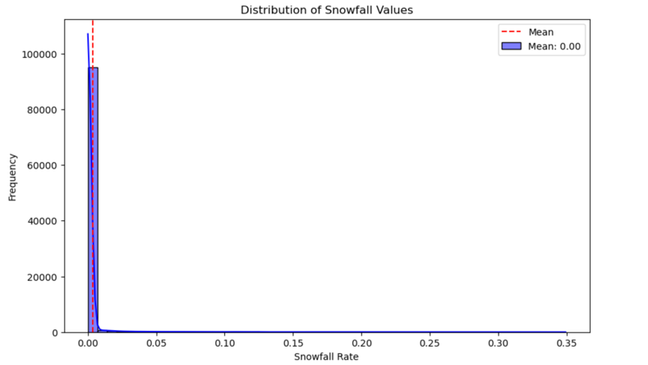
Quasi-Markov

Slide 25
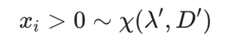
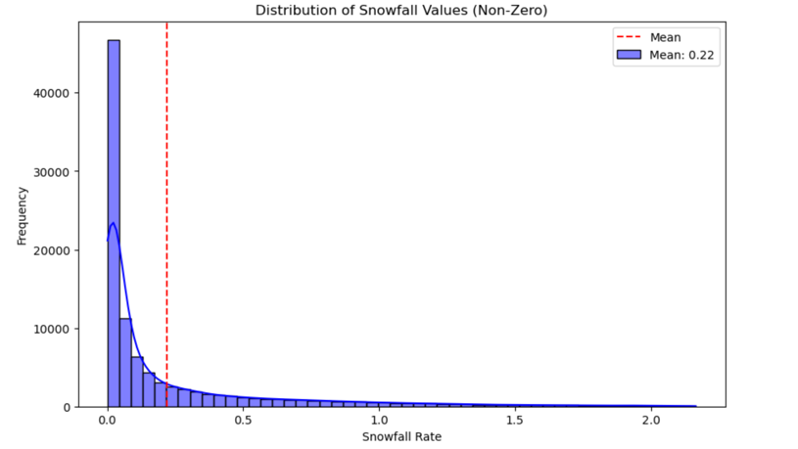
Quasi-Markov

Slide 26
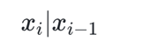
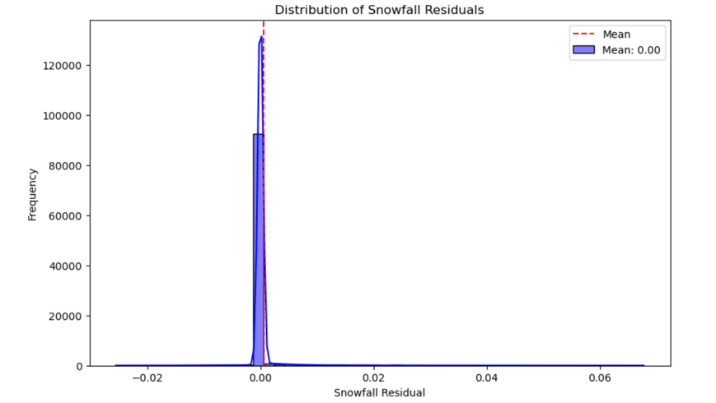
Quasi-Markov

Slide 27
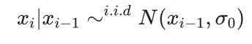
Quasi-Markov

Slide 28
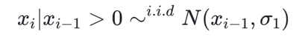
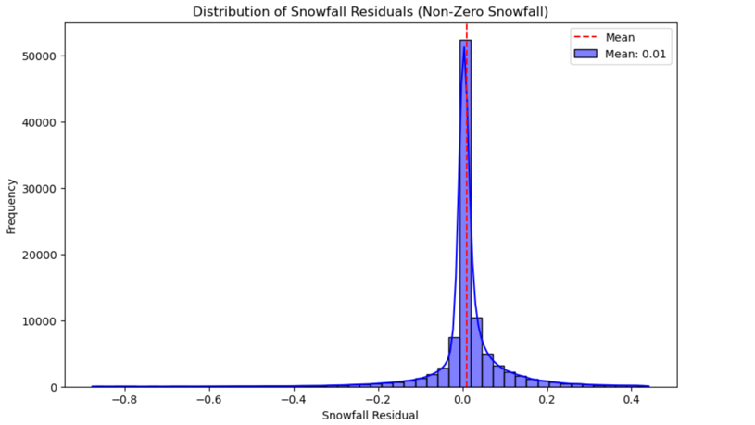
Quasi-Markov

Slide 29
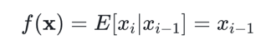
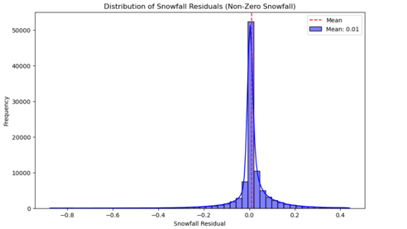

Quasi-Markov
The simplest Markov Chain
c
Exactly what the current baseline algorithm does

Slide 30
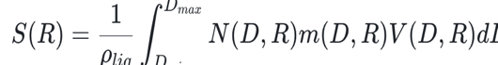
Quasi-Markov
Snowfall is a function of radar observable, an easy function
c
It’s genuinely a function of the local meteorology, but complex!
You see it, you see it; You don’t see it, you model it
Change-of-variable trick! But how to optimize the uncertainty?
Take advantage of the best information you have, then make up
the missing part using a compromising way

Slide 31
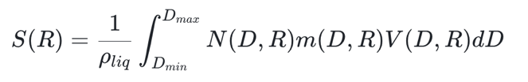
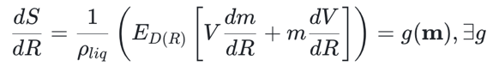
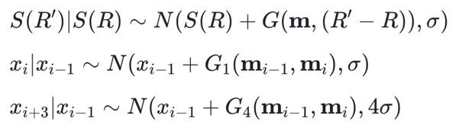
Quasi-Markov

Slide 32
Model architecture

Slide 33
Loss
Sequential regularization
0.7 * MSE()
Cor
S
More in the future
Stable convergence
Physical priori injection
Regularize the generalization

Slide 34
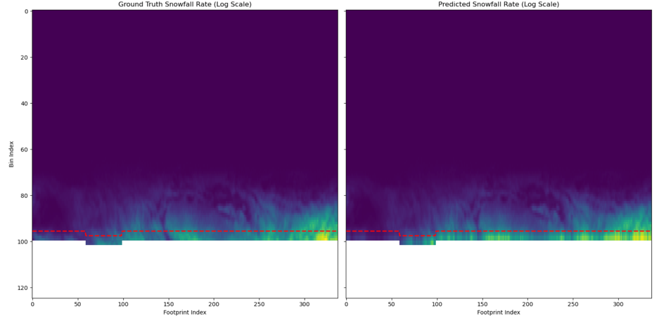
Model results

Slide 35
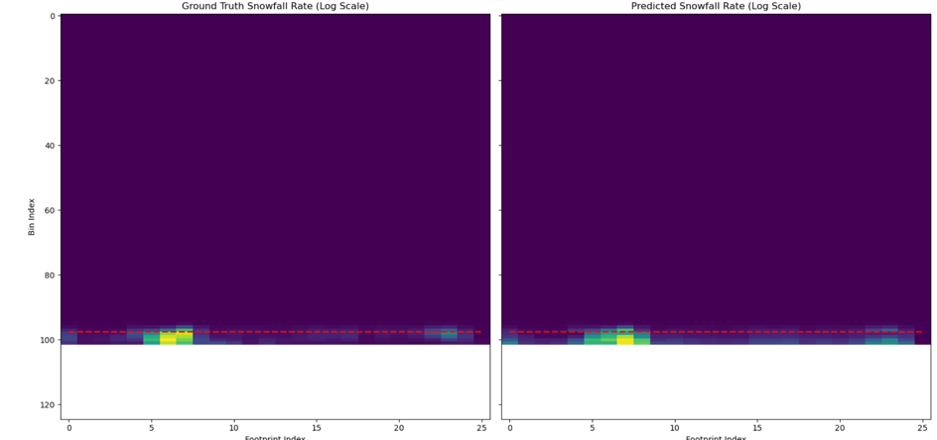
Model results

Slide 36
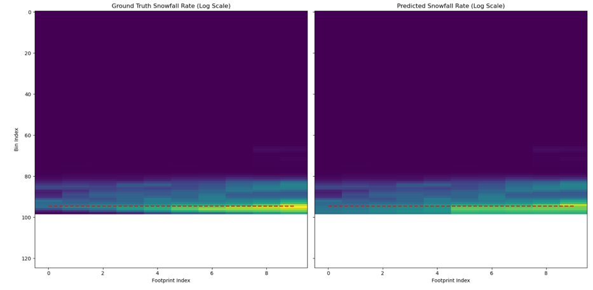
Model results

Slide 37
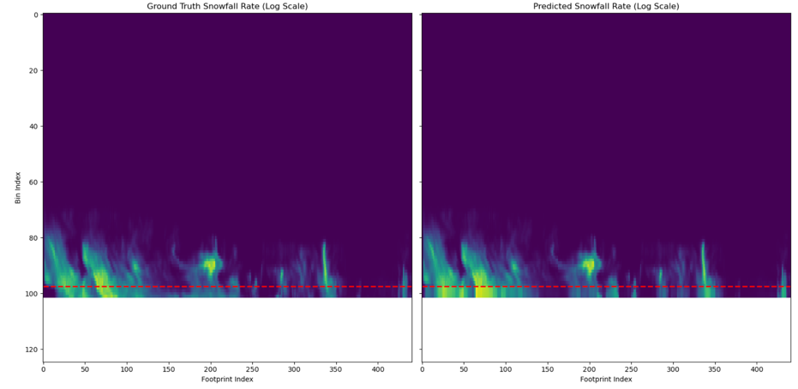
Model results

Slide 38
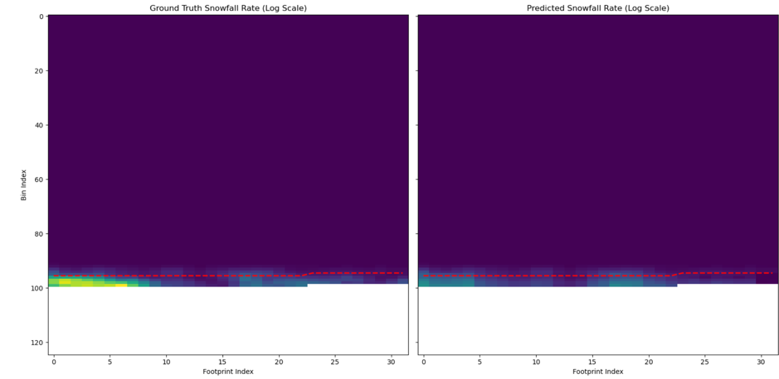
Model results

Slide 39
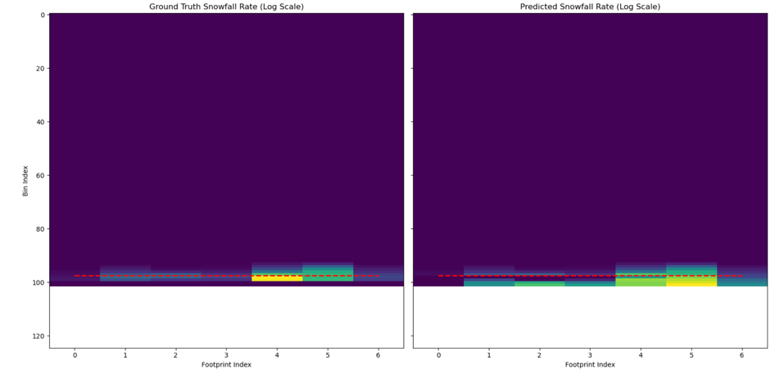
Model results

Slide 40
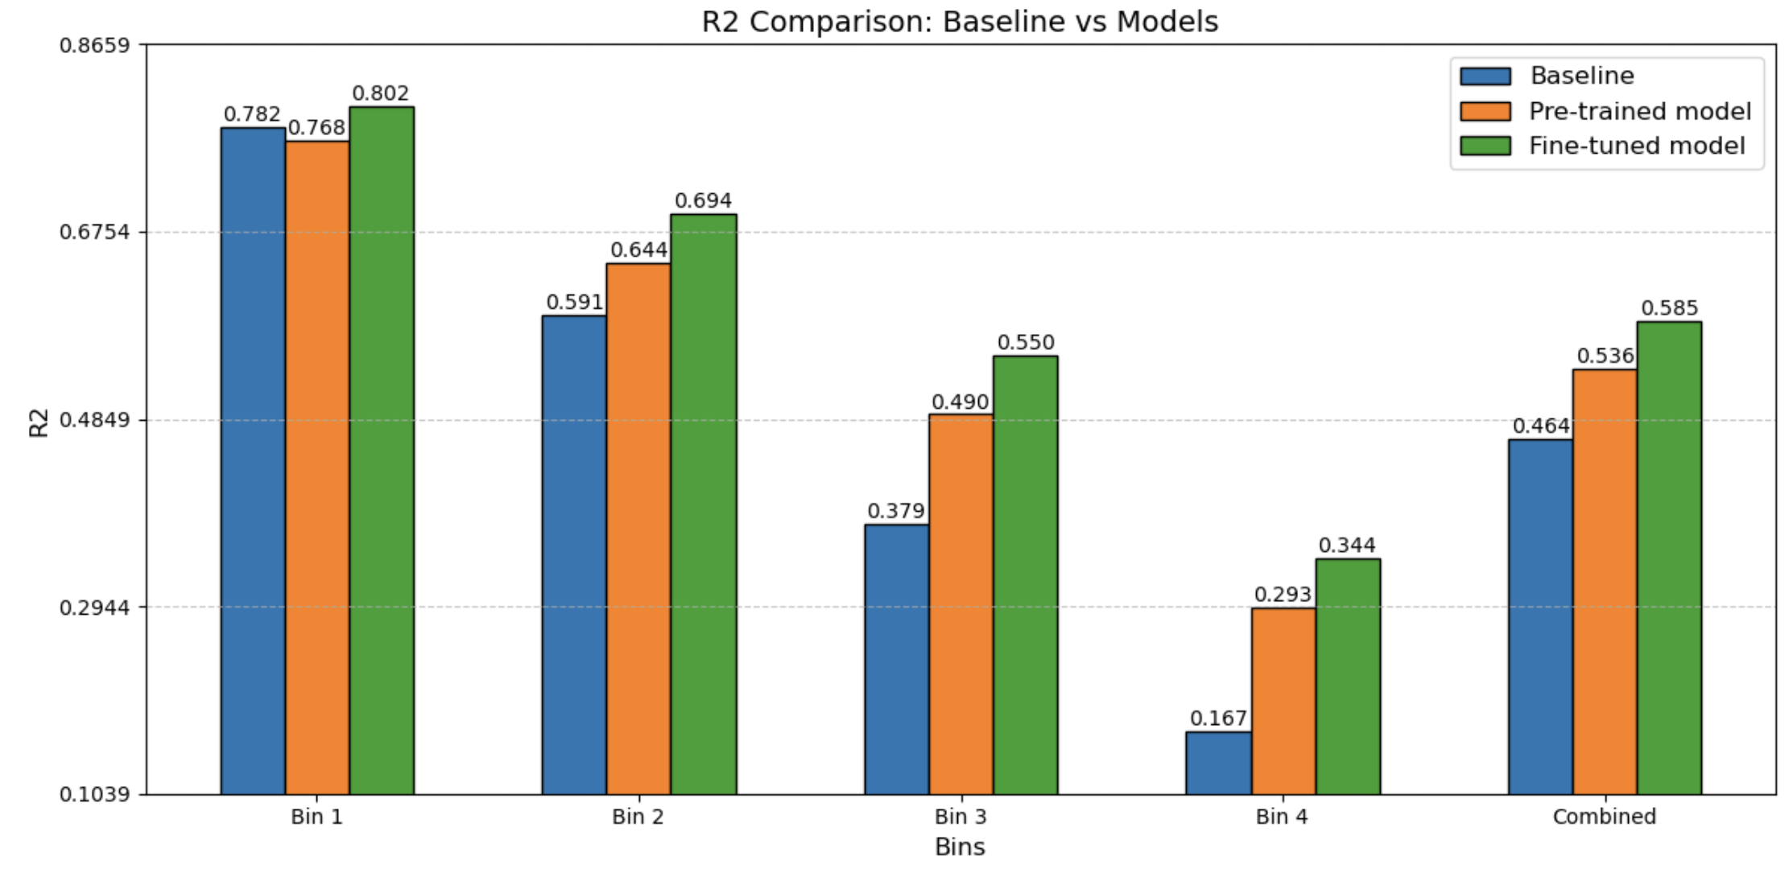
Model results
Overall performance

Slide 41
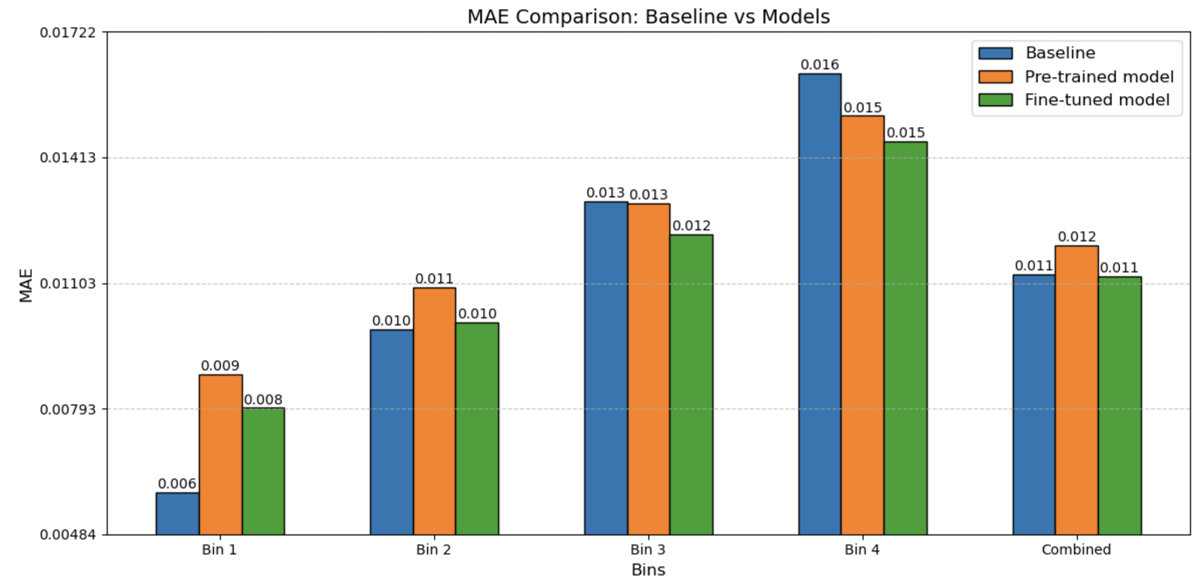
Model results
Overall performance

Slide 42
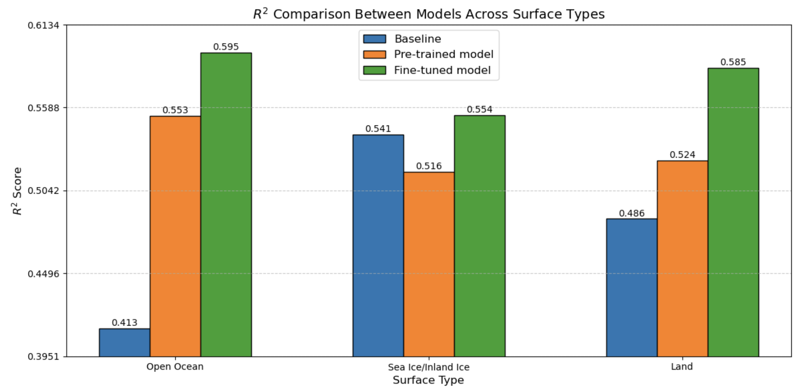
Model results
Generalizability over different surface types

Slide 43
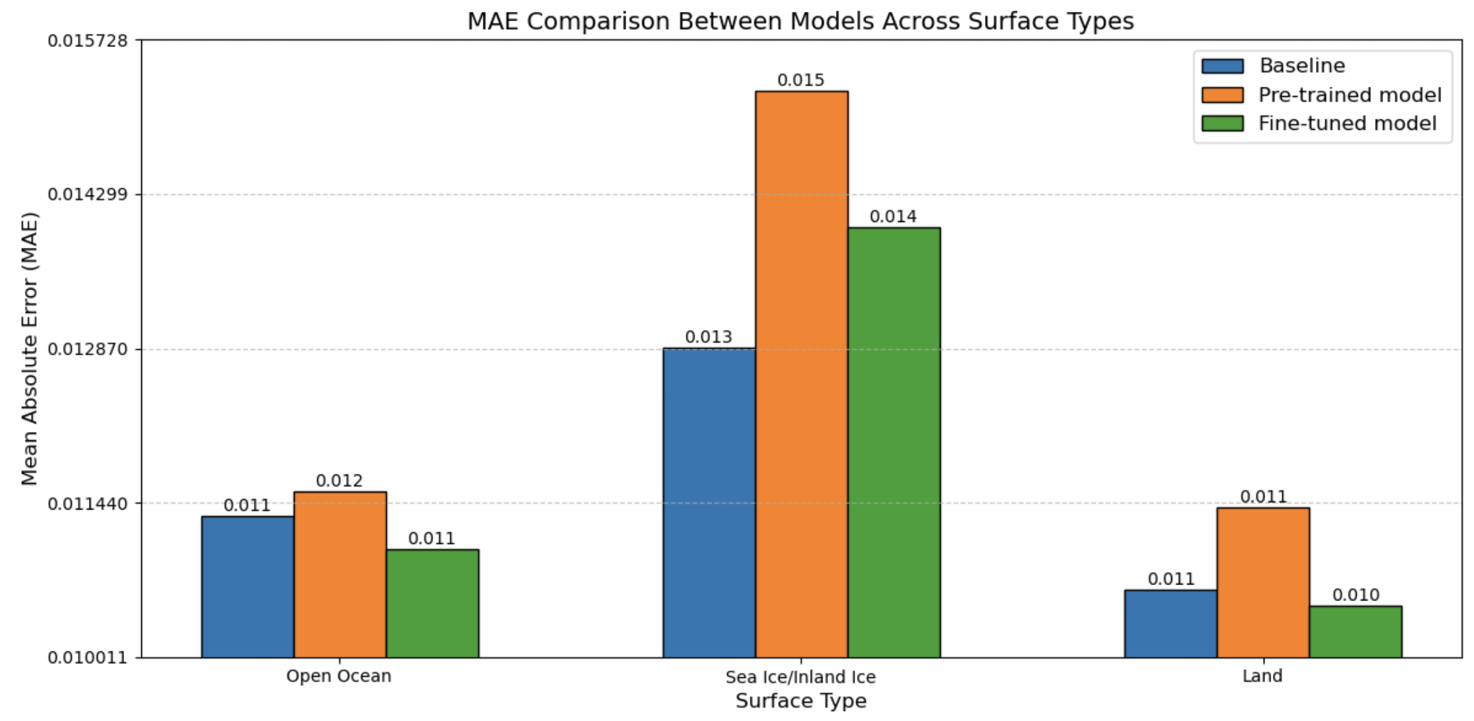
Model results
Generalizability over different surface types

Slide 44
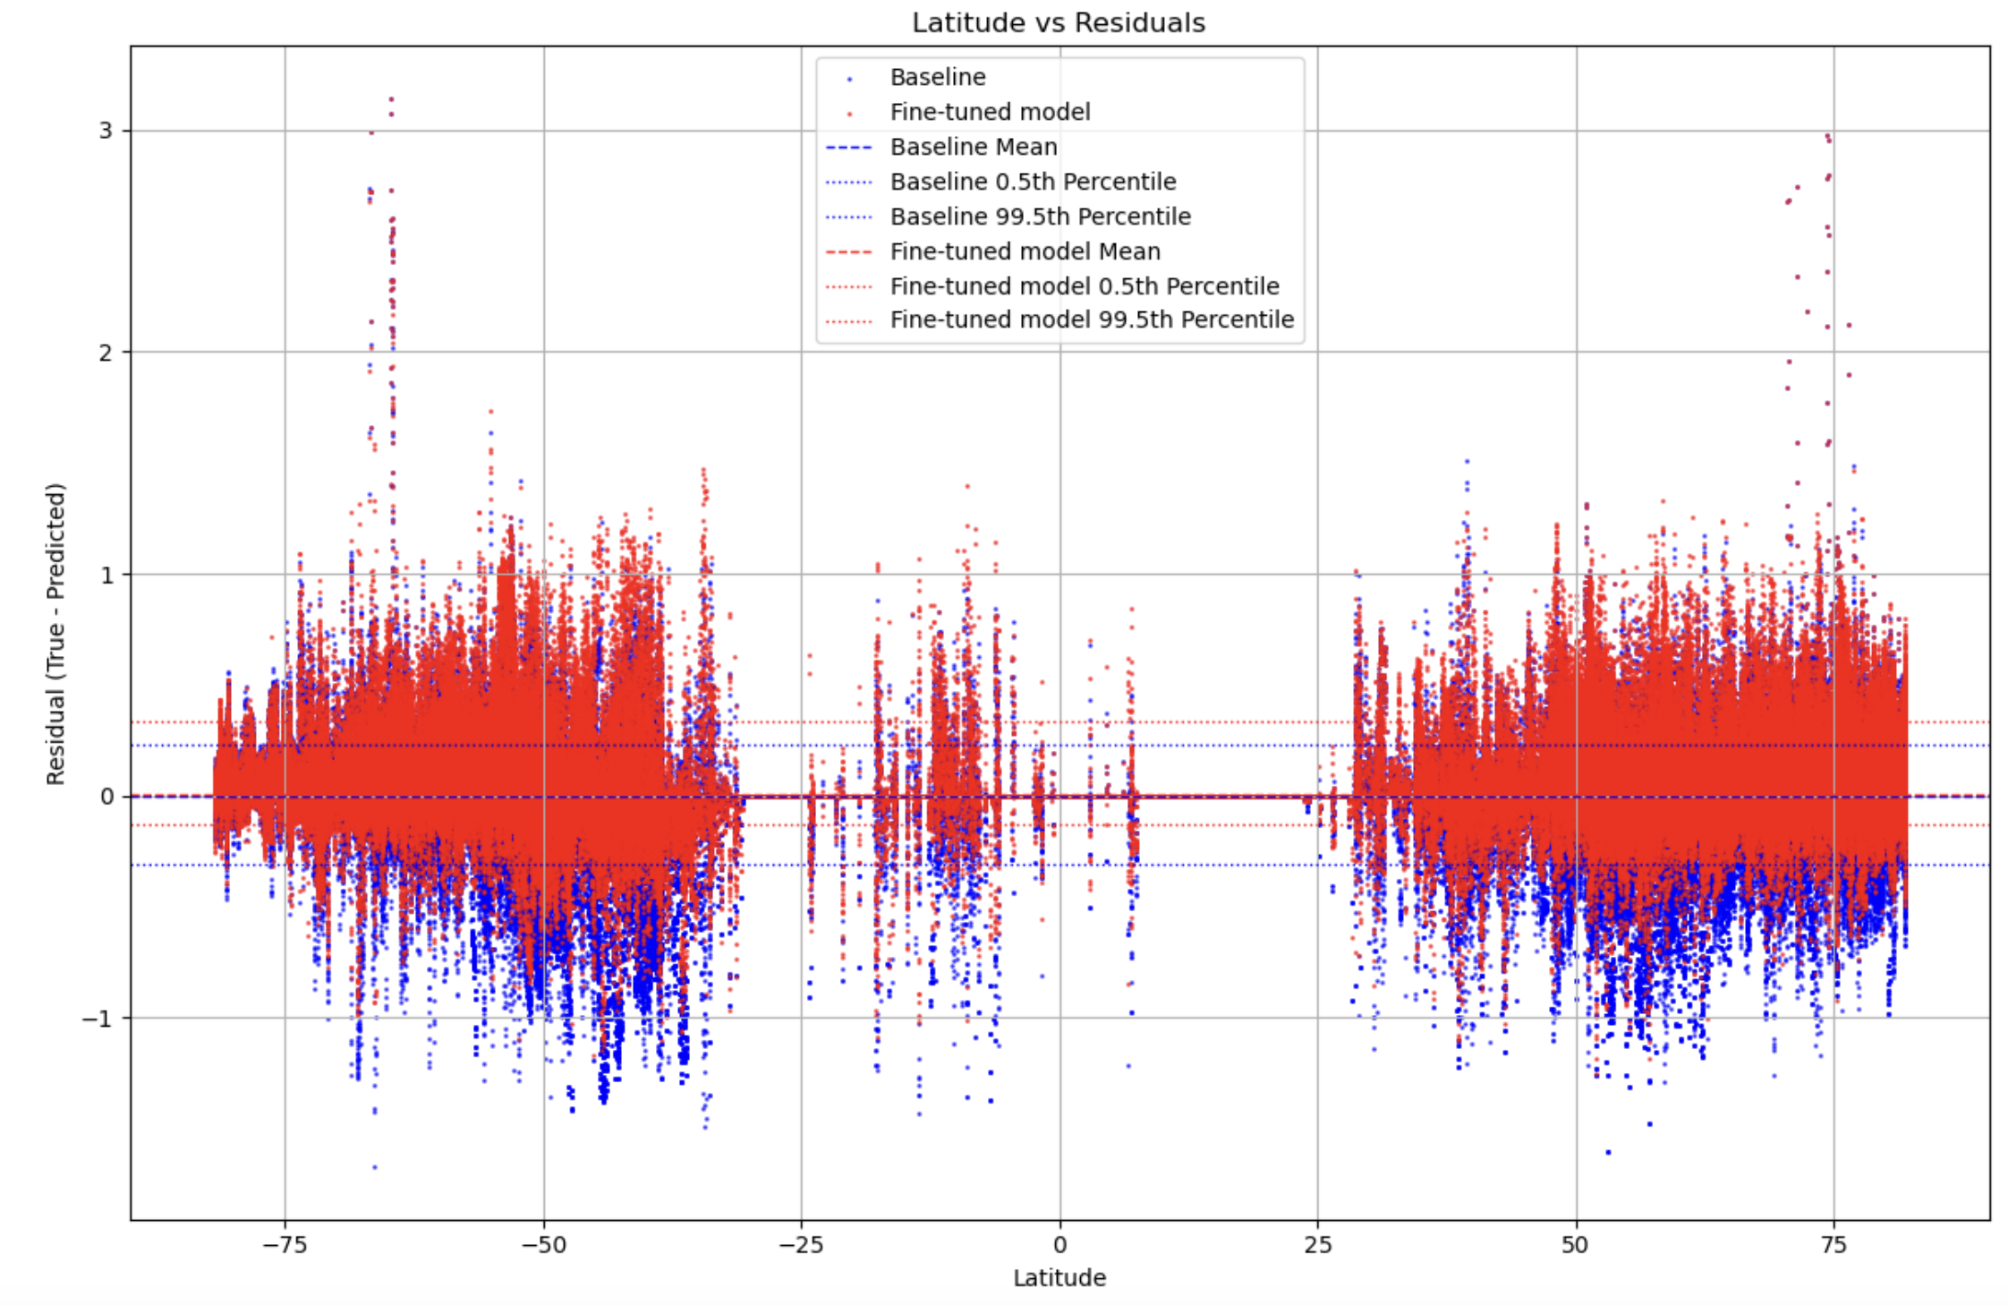
Model results
Horizontal Generalizability

Slide 45
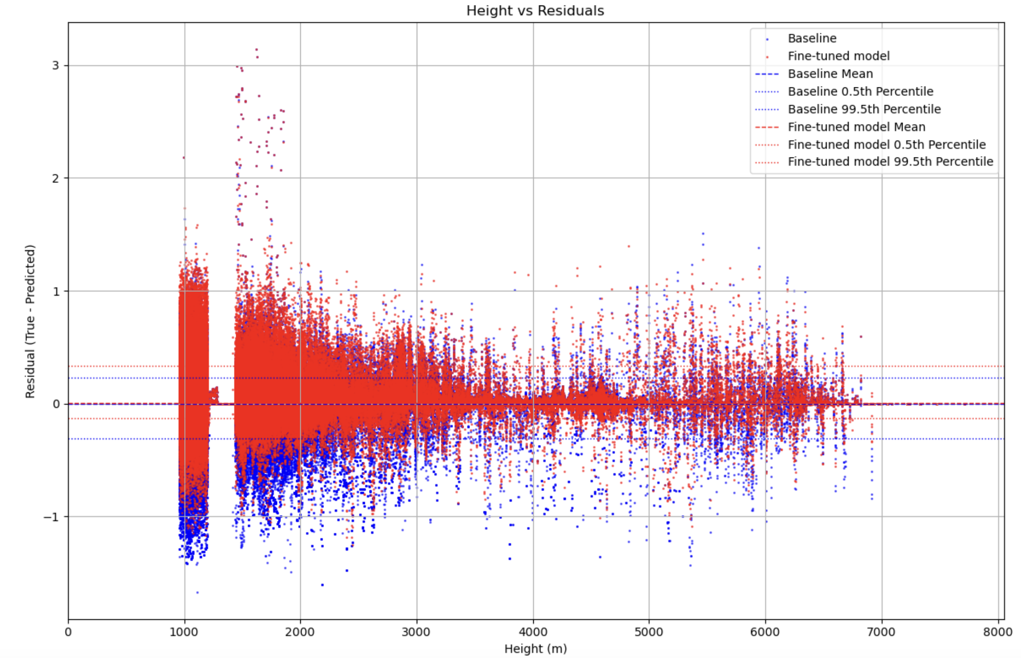
Model results
Vertical Generalizability

Slide 46
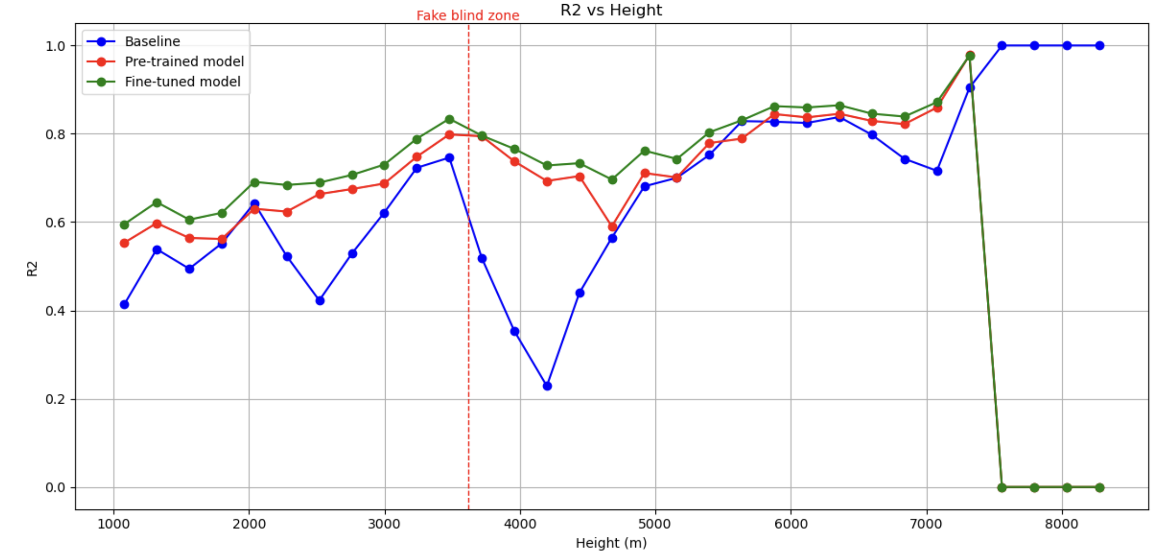
Model results
Fine-tune boosts the vertical domain adaptation

Slide 47
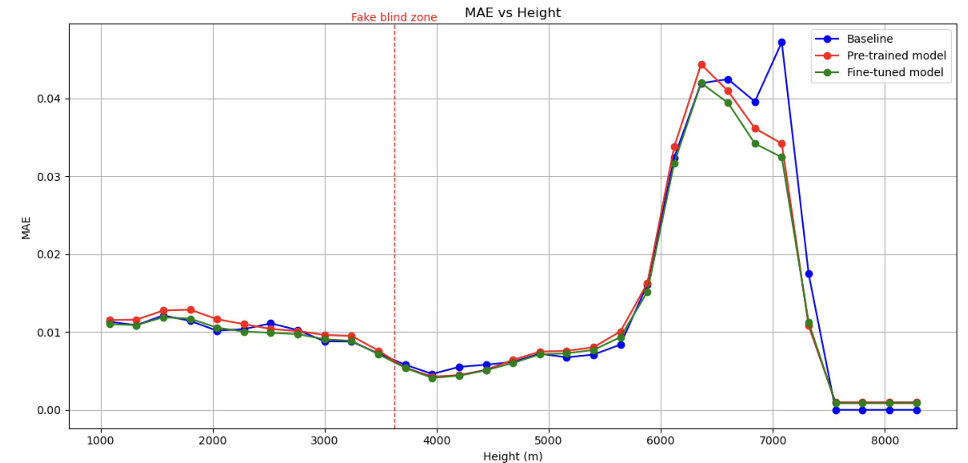
Model results
Fine-tune boosts the vertical domain adaptation

Slide 48
Conclusions by far
So far…
The missing near-surface profiles alter snowfall amount and frequency by >5%
Can be catastrophic if a model using it is sensitive!
My model outperforms the baseline model we are currently using
I suggest that we use the value-added data product from my model from now on
The model captures extreme weather much better than the baseline

Slide 49
Conclusions by far
In the future…
A more reliable quality assurance algorithm is being developed
A larger dataset or even an online learning framework might be developed
More deblackboxing for interpretability
Apply it to multi-source EOS missions based on its multimodal learning
Towards an Artificial Earth!

Slide 50
Thank you! See more in the near future!

